Slide 1
Introduction to JavaScript

Slide 2
Outline
What is JavaScript?
Embedding JavaScript with HTML
JavaScript conventions
Variables in JavaScript
JavaScript operators
Input output in JavaScript
JavaScript functions
Conditional Statements
Looping Statements

Slide 3
1. JavaScript
JavaScript is a client-side scripting language
JavaScript was designed to add interactivity to HTML pages
JavaScript is used in millions of Web pages to improve the design, validate forms, detect browsers, create cookies, and much more

Slide 4
1. JavaScript….
JavaScript is an interpreted language (means that scripts execute without preliminary compilation)
JavaScript is usually embedded directly into HTML pages
Everyone can use JavaScript without purchasing a license

Slide 5
1. JavaScript….
JavaScript is the most popular scripting language on the internet, and works in all major browsers, such as Internet Explorer, Mozilla, Firefox, Netscape, Opera

Slide 6
1.1 JavaScript: Common uses
JavaScript gives HTML designers a programming tool
JavaScript can react to events
JavaScript can read and write HTML elements
JavaScript can be used to validate data
JavaScript can be used to detect the visitor's browser
JavaScript can be used to create cookies

Slide 7
2. Embedding JavaScript in HTML
There are two methods to embed JavaScript in to HTML code
Internal Script: directly written in HTML code
External Script: written in separate file
<script> tag is used to tell the browser that a script follows

Slide 8
2.1 Internal Scripts
The <SCRIPT> tag is used to embed JavaScript code in HTML documents
<SCRIPT LANGUAGE="JavaScript">
[JavaScript Statements...]
</SCRIPT>
JavaScript can be placed anywhere between <HTML> and </HTML> tags
two possibilities are the <HEAD>…</HEAD>
portion and the <BODY>…</BODY> portion

Slide 9
2.1 Internal Scripts…
<HTML>
<HEAD><TITLE>Using Multiple scripts</TITLE>
<SCRIPT LANGUAGE="JavaScript">
[JavaScript statements...]
</SCRIPT>
<SCRIPT LANGUAGE="JavaScript">
[JavaScript statements...]
</SCRIPT>
</HEAD>
<BODY>
<H1>This is another script</H1>
<SCRIPT LANGUAGE="JavaScript">
[JavaScript statements...]
</SCRIPT>
</BODY></HTML>

Slide 10
2.2 External Script
We place script in a separate file and include this in HTML code
SRC attribute of the <SCRIPT> is used to include the external JavaScript file in HTML
<script src="myscripts.js"> </script>
Are useful when you have lengthy scripts
Improve the readability

Slide 11
3. JavaScript Conventions
Using the Semicolon
document.write("Hello"); alert("Good bye")
document.write("Hello")
alert("Good bye")
document.write("Hello");
alert("Good bye");
Case Sensitivity
Comments:
single line //
Multiple lines /* */

Slide 12
3. JavaScript Conventions…
Using Quotes
document.write(“<font color=“red”>Hello World</font>”)
document.write(“<font color=‘red’>Hello World</font>”)

Slide 13
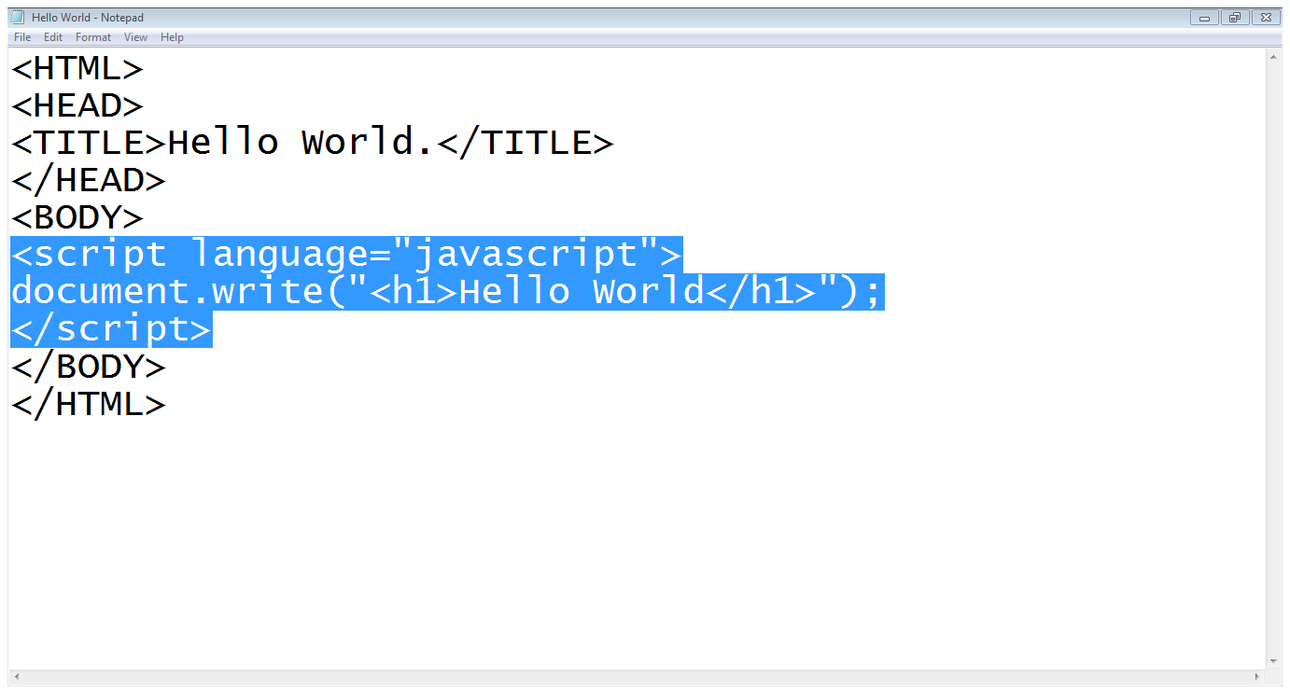
4. Writing JavaScript
Start of JS script
Writing on webpage
HTML code in JS
End of JS script

Slide 14
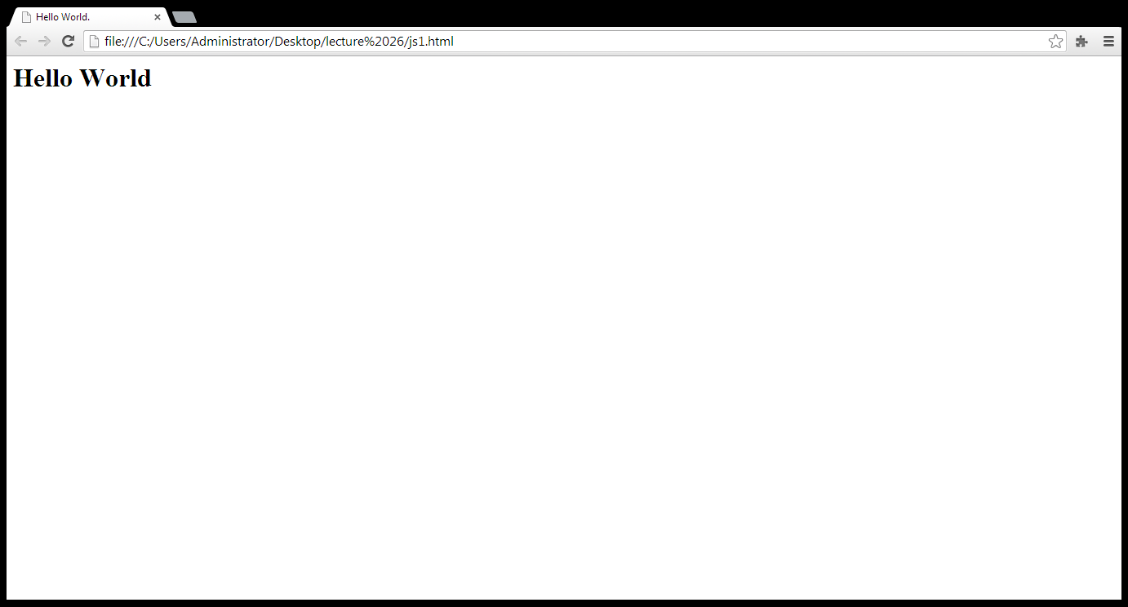
4. Writing JavaScript…
Out put of the JS code

Slide 15
4.1 Variables in JavaScript
Variable is the name of a memory location which holds the data of a certain type (data types)
There are four common data types in JavaScript
numbers, strings, Boolean, null values
JavaScript is a loosely typed language

Slide 16
4.1 Variables in JavaScript…
The word “var” is used to declare a variable
var LastName = “Smith”
var AccountNumber = 1111
Variable Naming
First character can not be a digit
Other characters may be digits, letters or underscore
Reserved words can not be used
Case sensitive

Slide 17
4.1 Variables in JavaScript…
Variable Initialization
var variableName = initialValue
var variableName1 = initialValue1, variableName2 = initialValue2, …

Slide 18
5. JavaScript Operators
An operator is simply a symbol that tells the compiler (or interpreter) to perform a certain action
Assignment Operator: =
Arithmetic Operators: +, - , *, /, %, ++, --
Logical Operators: &&, ||, !
Comparison Operators: ==, ===, !=, !==, <, >, <=, >=

Slide 19
6. Input Out put in JavaScript
write(); is used to write on browser
document.write(“hello world”)
document.write(a)
prompt(); is used to take input from users
var num = prompt(“Please Enter a Number”, 0)

Slide 20
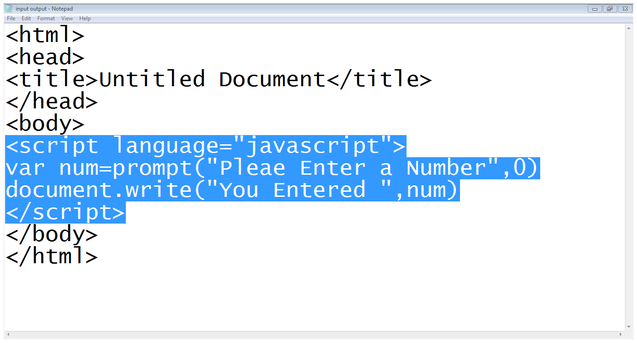
6. Input Out put in JavaScript…
Start of JS code
User input
Writing on browser
End of Script

Slide 21
7. JavaScript Function
User defined functions
Predefined functions

Slide 22
7. JavaScript Function…
Functions are defined using the keyword function, followed by the name of the function and list of parameters
function functionName([parameters])
{
[statements]
}

Slide 23
7. JavaScript Function…
Calling a function
The syntax of a function call is:
functionName([arguments])

Slide 24
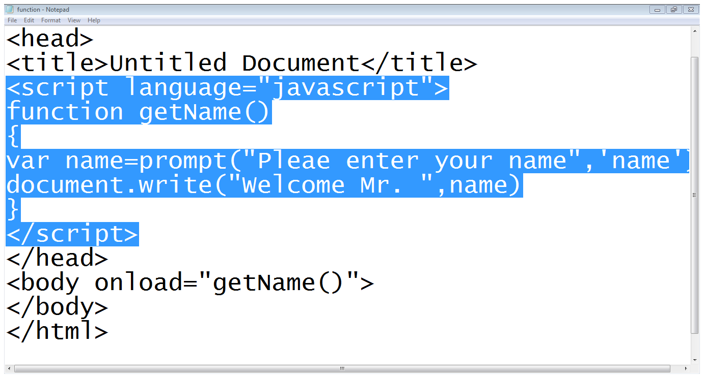
7. JavaScript Function…
Start of the function
Asks user to enter name
Writes name on the webpage
Calling a function

Slide 25
7. JavaScript Function…
Common events
onClick
onDblClick
onChange
onFocus
onMouseOver
onMouseOut
onSubmit
onload

Slide 26
7. JavaScript Function…
Some common predefined math functions
Math.sqrt
Math.pow
Math.abs
Math.max
Math.min
Math.floor
Math.ceil
Math.round
Math.random

Slide 27
8. Conditional Statements
If statement
if (condition)
statement
if(condition)
{ statements }
If-else statement
if(condition)
{statement}
else
{statements}

Slide 28
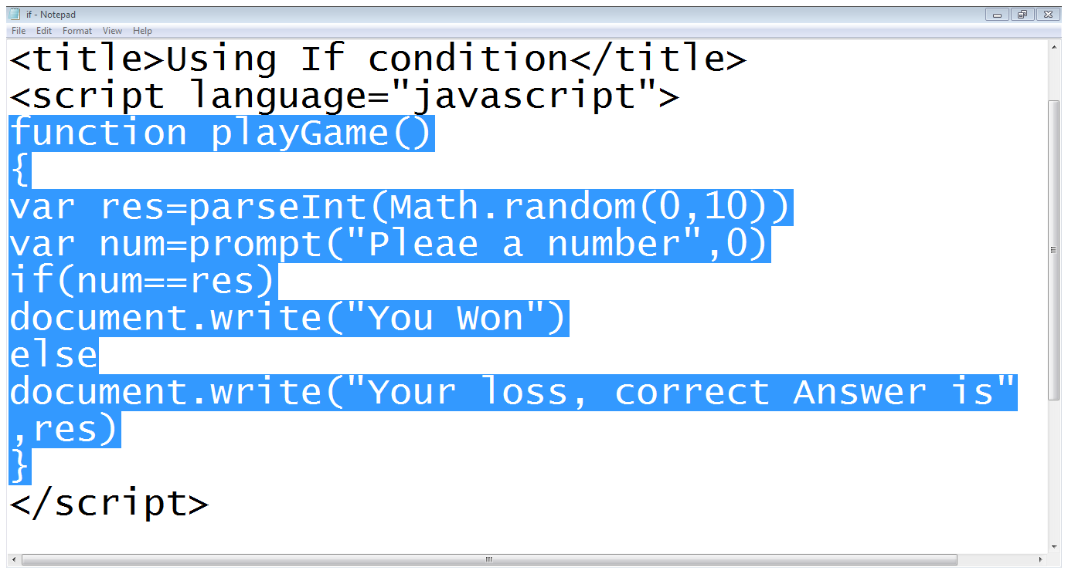
8. Conditional Statements…
Random number is generated
)*10
User’s Input
If condition

Slide 29
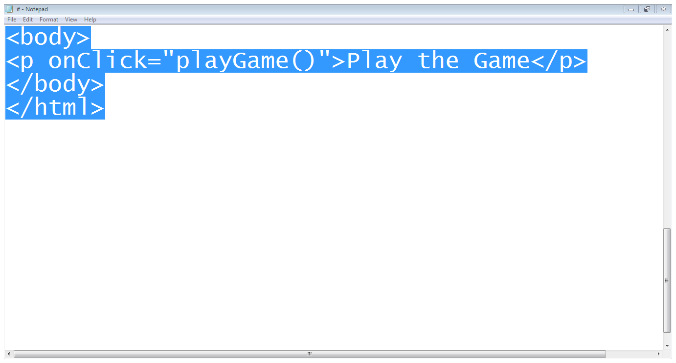
8. Conditional Statements…
text
On click event

Slide 30
9. Loops
For loop
for(var i=1; i<10; i++)
{
Document.write(“hello world”)
}
While loop
While(condition)
{
}

Slide 31
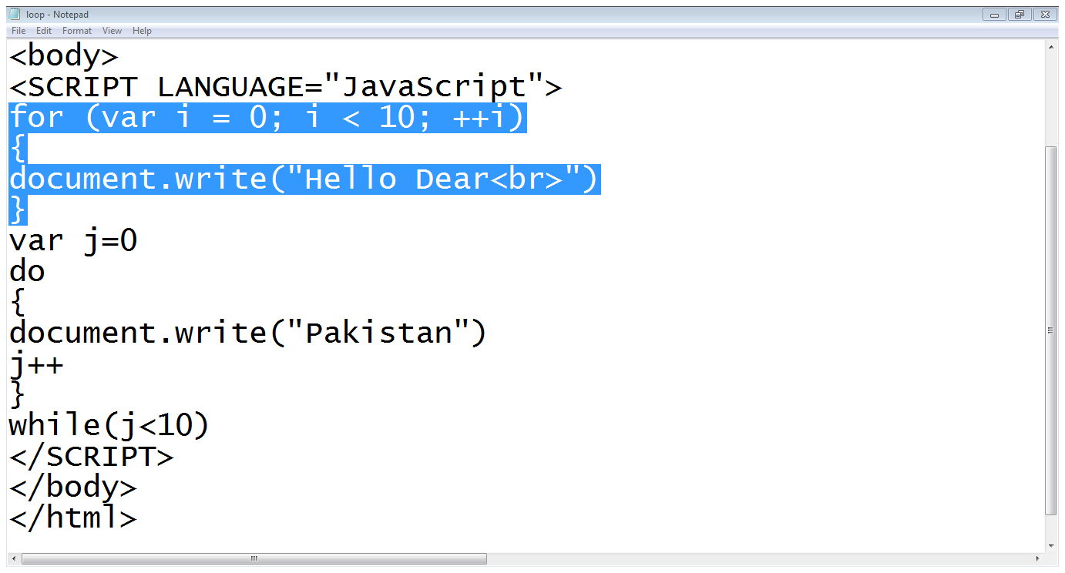
9. Loops
For loop
Do-while loop

Slide 32
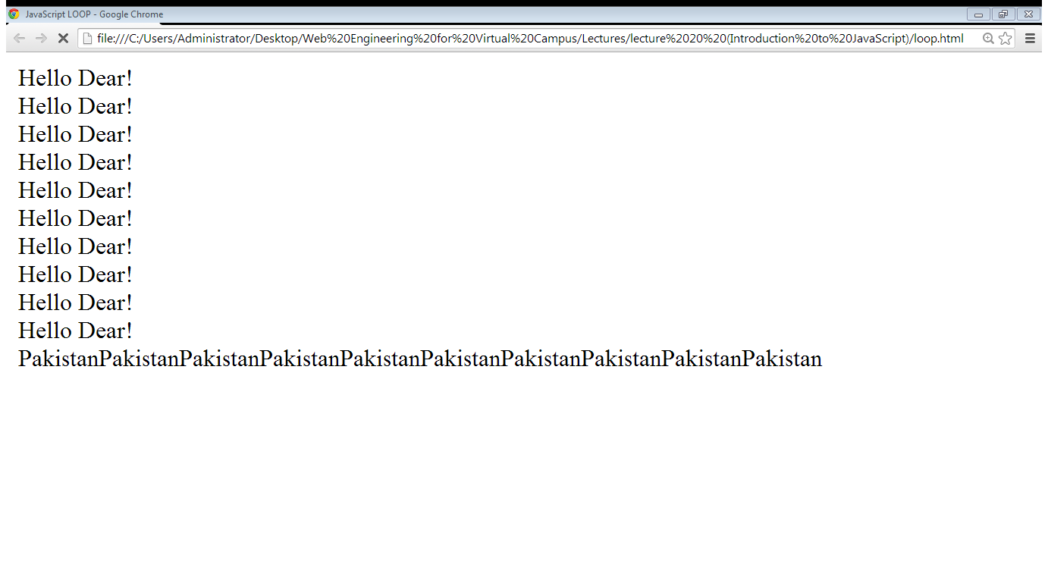
9. Loops
Output of for loop
Output of do-while loop

Slide 33
Summary
What is JavaScript?
Embedding JavaScript with HTML
JavaScript conventions
Variables in JavaScript
JavaScript operators
Input output in JavaScript
JavaScript functions
Conditional Statements
Looping Statements

Slide 34
References
Chapter 11. Beginning HTML, XHTML,CSS, and JavaScript, by Jon Duckett, Wiley Publishing; 2009, ISBN: 978-0-470-54070-1.
Chapter 2, Learn JavaScript, by Chuck Easttom, Wordware Publishing; 2002, ISBN 1-55622-856-2

